Slide 2
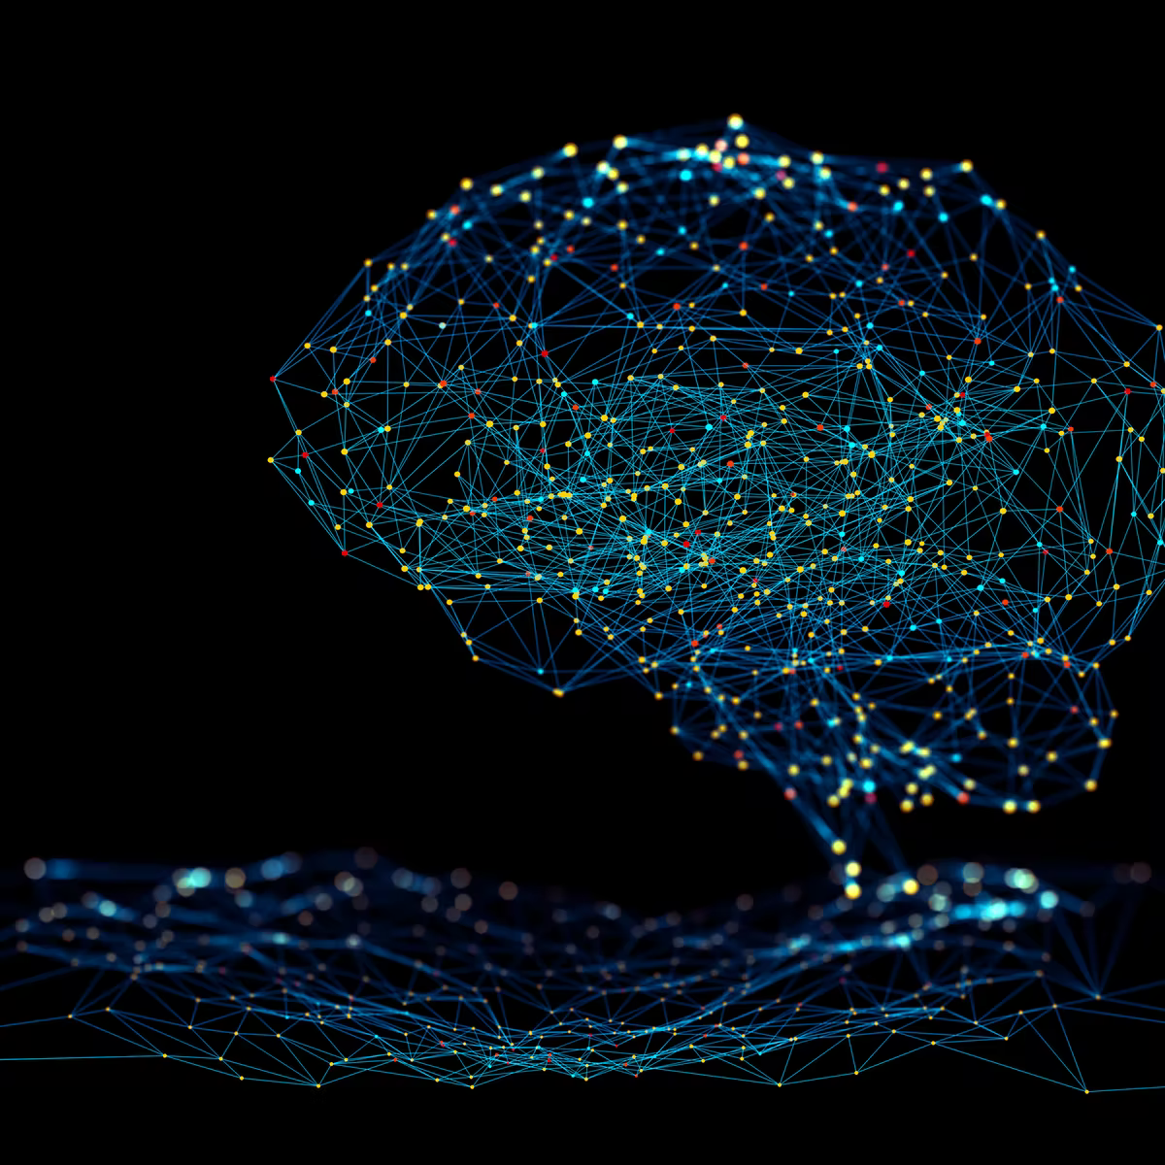
CNNs, Generation, RNN,,
Bryan Cardenas
Robert Jan Schlimbach
Caspar van Leeuwen

Slide 3
Background Prerequisites
How do we let computers see something?
How do we see something

Slide 4
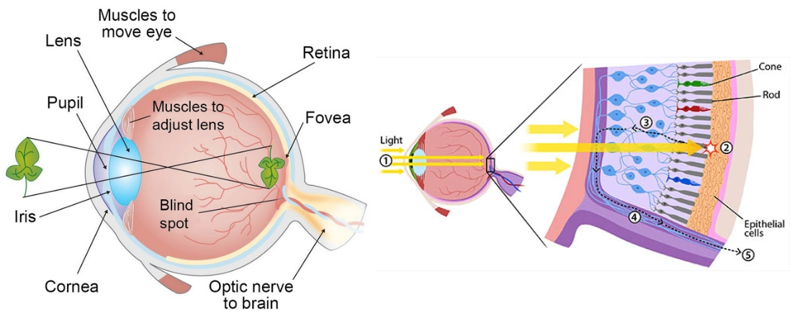
Human eyes

Slide 5
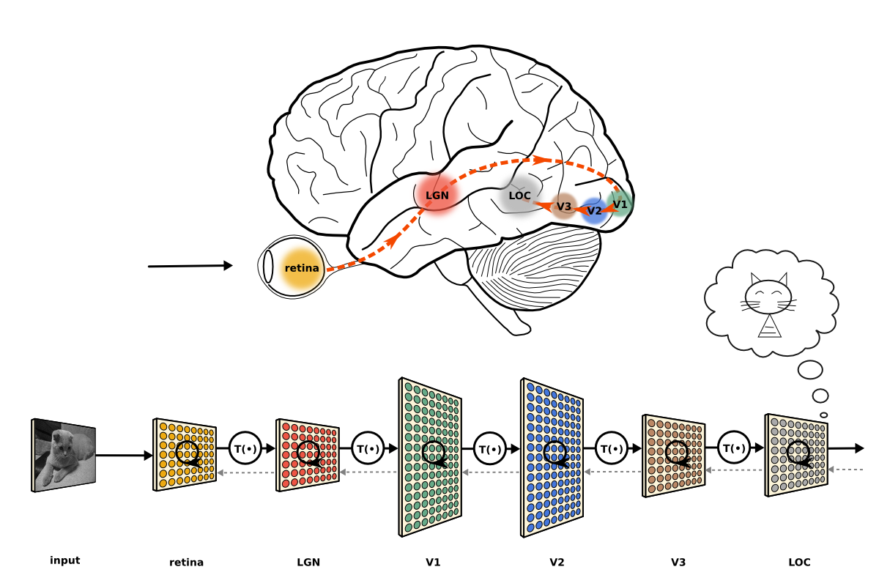
Human eyes

Slide 6
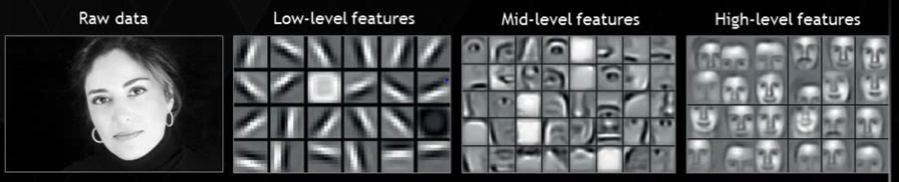
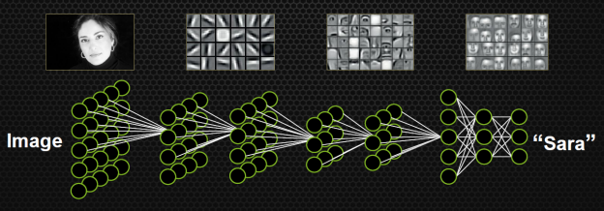
Convolutional Neural Network

Slide 7

Convolutional Neural Network

Slide 8
Representation of images in computers?
An image
Is a matrix/array of intensity values
Usually consists of integers [0, 255] or float points [0,1]
Each element in the matrix is a pixel
Can have 1 greyscale channel or multiple colour channels: RGB

Slide 9
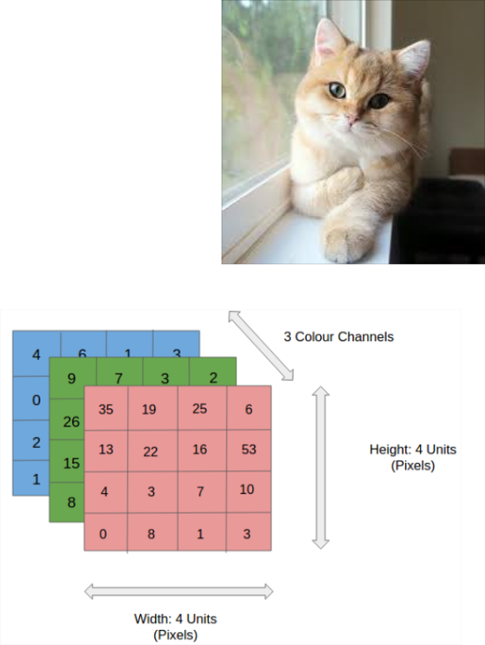
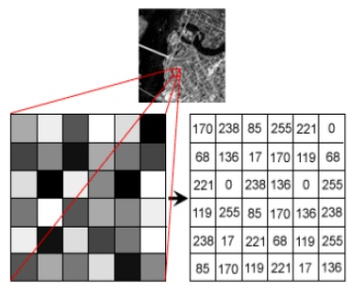
Representation of images in computers?
An image
Is a matrix/array of intensity values
Usually consists of integers [0, 255] or float points [0,1]
Each element in the matrix is a pixel
Can have 1 greyscale channel or multiple colour channels: RGB
3D Array. Shape: (width, height, channel)
2D Array. Shape = (width, height)

Slide 10




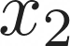
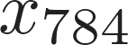

Representation of images in computers?
We will use a neural network to recognize
Hand written digits
...
...
...
...
images of size 28x28 = 784 pixels

Slide 11
Representation of images in computers?
We will use a neural network to recognize
Hand written digits
...
...
...
...
images of size 28x28 = 784 pixels
Inefficient: Every pixel is connected to everything
Regions in Images share features
Not shift invariant

Slide 12
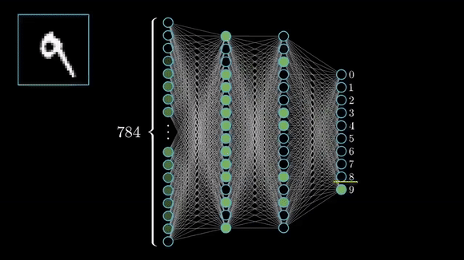
Representation of images in computers?
We will use a neural network to recognize
Hand written digits
...
...
...
...
images of size 28x28 = 784 pixels
Inefficient: Every pixel is connected to everything
Regions in Images share features
Not shift invariant

Slide 13
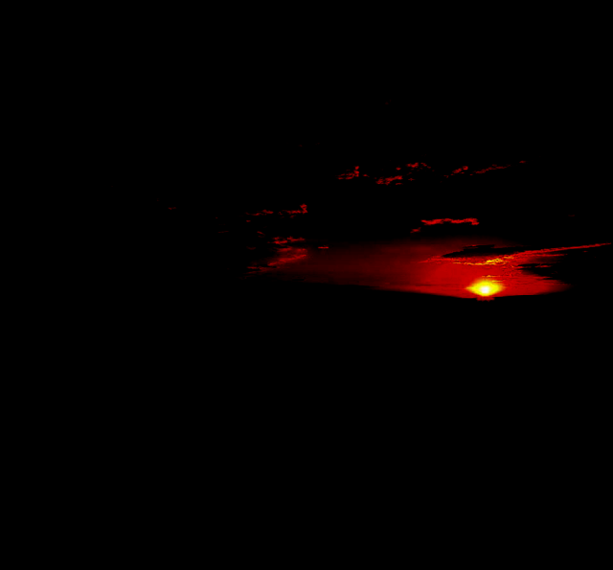
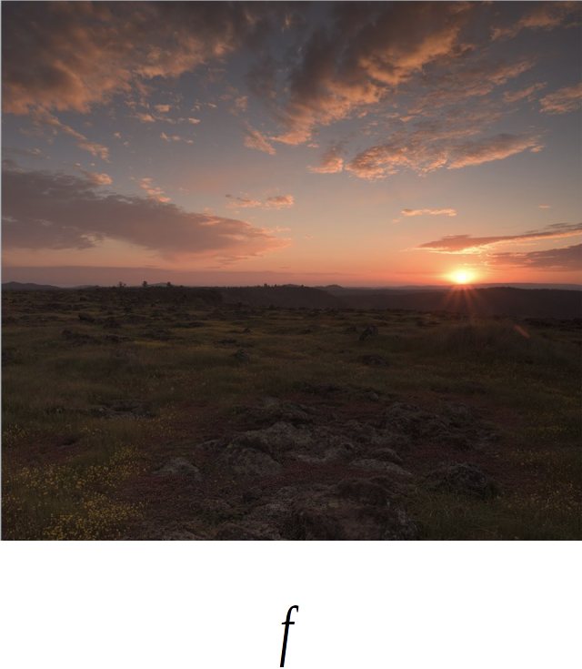
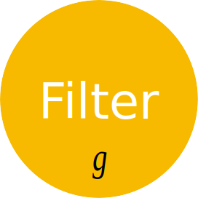
Convolutions
Filters

Slide 14
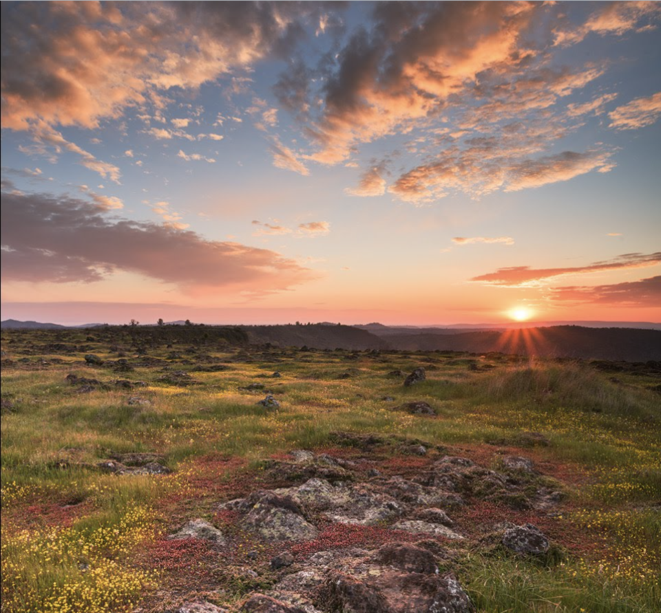
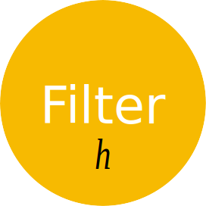
Convolutions
Filters

Slide 15
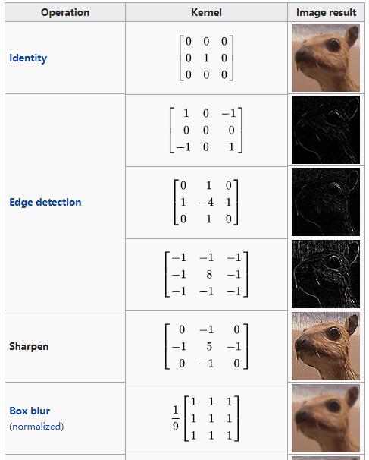
Convolutions
A filter applies a convolution operation upon the original signal
Kernel (filter): small matrix that we use to convolve an image
Convolution:
An operation that “blends” one function with another.

Slide 16
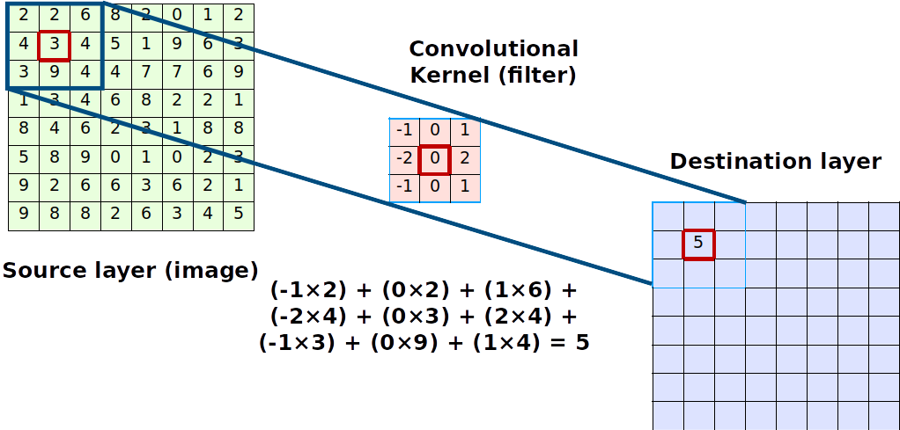
Convolutions

Slide 17
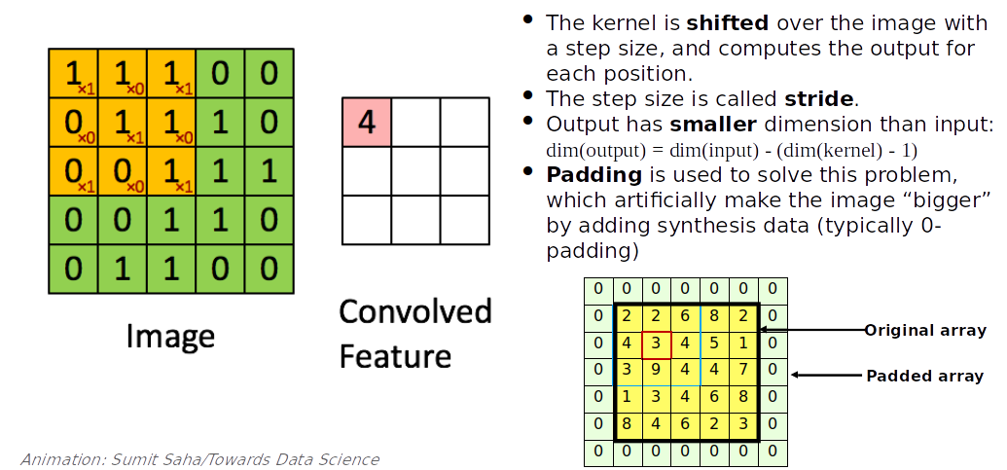
Convolutions

Slide 18
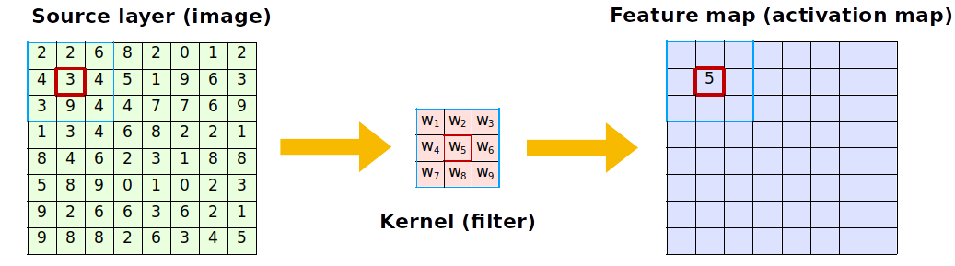
Convolutions
How do we know which kernels to use?
Kernels are learnt!
Initialized randomly
Backward propagation; the CNN learns which features to detect

Slide 19
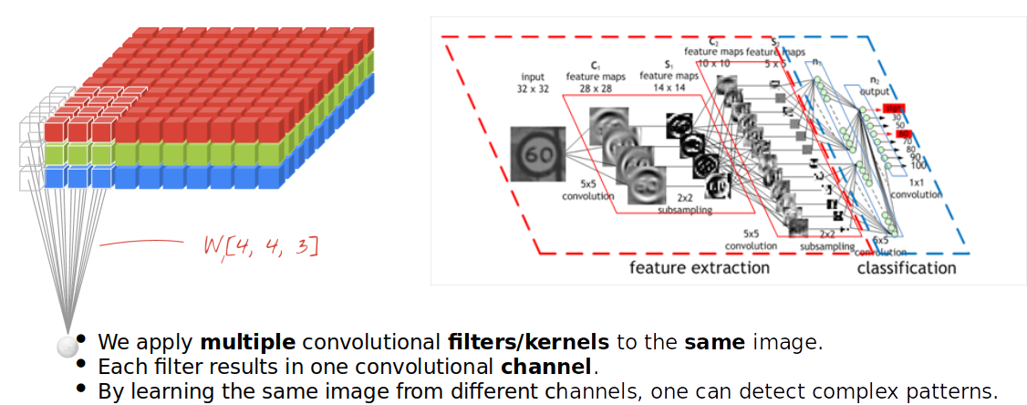
Convolutions

Slide 20
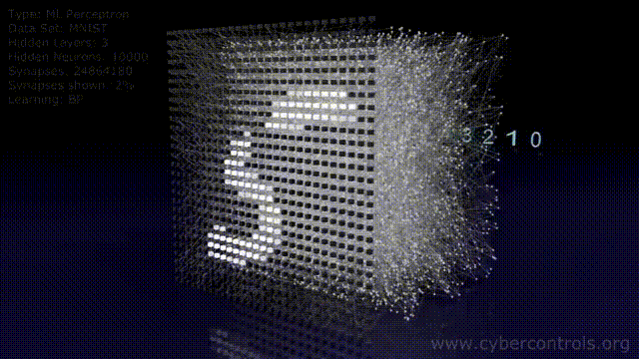
Convolutions

Slide 21

CNN Form
Two parts:
Feature Learning
Classification (fully connected layers)
Images become smaller and number of filters increases as we go deeper
Complex Images -> we need more filters
Easy images -> we need fewer filters

Slide 22
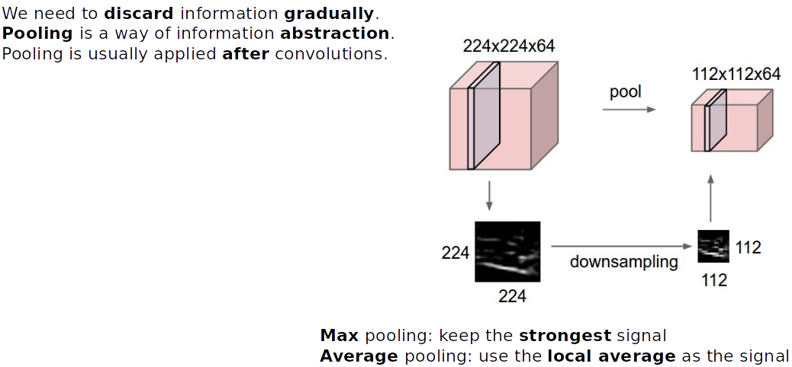

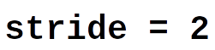
Pooling (downsampling)
Animation: Google Developers

Slide 23

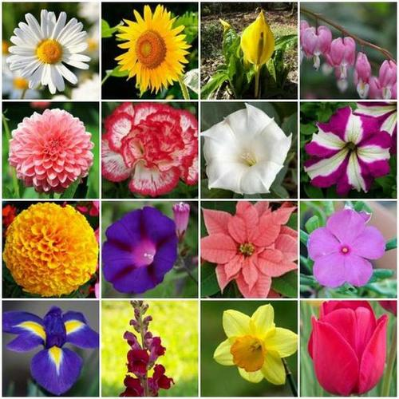
Transfer Learning
Continue Training
Trained
CNN
CNN reuses its knowledge; its features

